Slide 1
B.7 ASCII Encoding
ord() and chr() functions

Slide 2
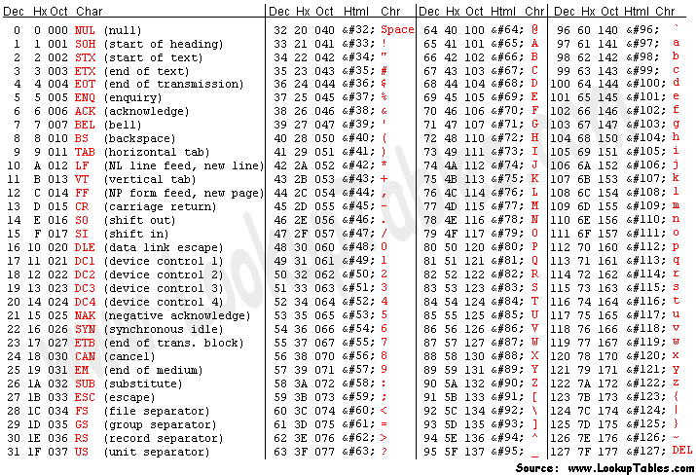
The ASCII Table

Slide 3
What is ASCII
What does the ASCII acronym stand for?
American Standard Code for Information Interchange
What is the ASCII code used for?
Representing and storing text in computers
Computers can only understand numbers (binary)
Text symbols must be encoded as numbers
Encoding text for electronic communication (e.g. web)
Sending and receiving computers must both agree and understand the same encoding standard

Slide 4
Encoding Text Characters
Use the ACSII Table to look up the matching codes
What is the ASCII code for the letter “A” 65
What is the ASCII code for the letter “a” 97
Why are they different? Upper case and lower case are different symbols. The computer doesn't really know what the alphabet is or how to read and write.
What is the ASCII code for the space bar? 32 The ASCII code also includes some "un-printable" characters.

Slide 5
Encoding Text Characters
Use the ACSII Table to look up the matching codes
What is the ASCII code for the letter “A” 65
What is the ASCII code for the letter “a” 97
Why are they different? Upper case and lower case are different symbols. The computer doesn't really know what the alphabet is or how to read and write.
What is the ASCII code for the space bar? 32 The ASCII code also includes some "un-printable" characters.

Slide 6
Decoding ASCII Code Numbers
Use the ACSII Table to look up the matching text
What character corresponds to ASCII code 61 decimal =
What character corresponds to ASCII code 8 decimal backspace
Why is the character 8 not the same as ASCII code 8 Character "8" is text symbol, code 8 is an number. Symbols and numbers are different things to a computer.
What is the range of non-printable characters in ASCII Codes 0 to 31

Slide 7
Decoding ASCII Code Numbers
Use the ACSII Table to look up the matching text
What character corresponds to ASCII code 61 decimal =
What character corresponds to ASCII code 8 decimal backspace
Why is the character 8 not the same as ASCII code 8 Character "8" is text symbol, code 8 is an number. Symbols and numbers are different things to a computer.
What is the range of non-printable characters in ASCII Codes 0 to 31

Slide 8
ASCII Strings
A String is a sequence of individual text characters
How would you code the string “Hello” in ASCII?
How would you code the string “127” in ASCII?
What is the difference between 127 and “127”?

Slide 9
ASCII Strings
A String is a sequence of individual text characters
How would you code the string “Hello” in ASCII?
How would you code the string “127” in ASCII?
What is the difference between 127 and “127”? 127 is an integer number. Computers don't need to use ASCII for numbers. "127" is a string of text symbols. A human might see this as the number 127. A computer doesn't know it's a number.
H e l l o
72 101 108 108 111
2 7
49 50 55

Slide 10
Student Question #2
Google "Unicode"
Unicode can handle characters for almost all modern languages and even some ancient languages at the same time, as long as the client has fonts for the particular language installed in his system.
Google UTF
UTF is an encoding that implements the Unicode standard and goes beyond 8-bits to support almost every language in the world. Versions include UTF-8, UTF-16, and UTF-32 (8, 16, and 32 bits)
ASCII is contained within UTF-8

Slide 11
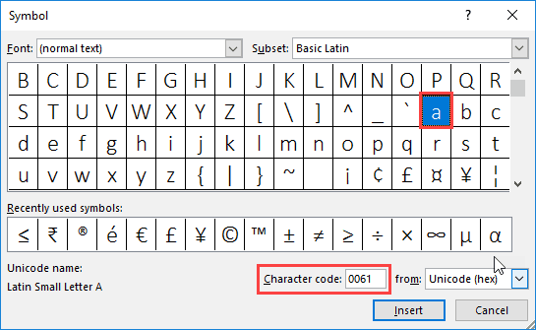
Unicode

Slide 12
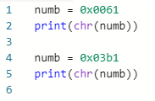
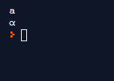
Python
Try this:

Slide 13
Student Question #5 & 6
Start with this code from B.2
Modify it for text and ASCII conversion
value = int(input("Enter a number:"))
value2 = value ** 2
print("The square of %d is %d" % (value,value2))

Slide 14
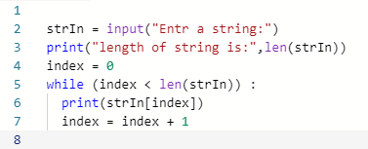
Student Question #7
Modify this template:

Slide 15
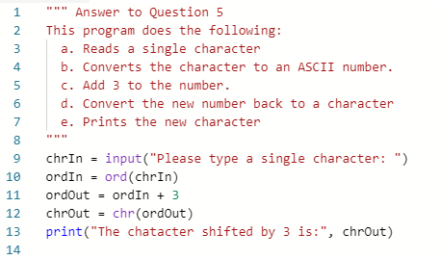
Example 5

Slide 16
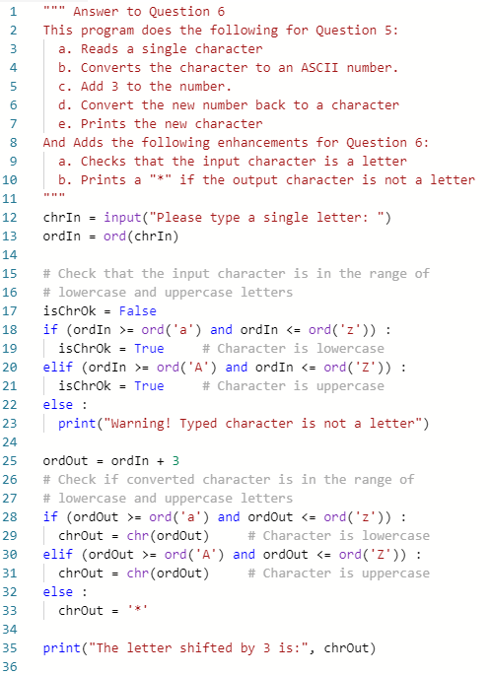
Example 6

